Slide 1
How much energy did the outage cost?
WATT THE HACK 2026 · CHALLENGE 1
Rebuilding a wind park’s lost energy from its neighbours, with an honest uncertainty range
[Team name] · [Names]
Notes:
About 5 seconds. Introduce the team in one breath and go straight to the problem.

Slide 2


Park T is down for three days
THE PROBLEM
Park H
Park T
Park O
5 turbines
3 turbines
2 turbines
Wind measured
Wind unknown during the outage
Wind measured
The insurer asks: how many kWh did the outage cost? We rebuild T’s wind from H and O, convert it to power and add it up.
Watt The Hack 2026 · Judged outage: 1–3 Sep 2026, 432 ten-minute steps · 2 / 8
Notes:
About 20 seconds. Park T, three turbines, is out for three days. The neighbouring parks H and O kept measuring. The insurer needs one number: the lost energy in kWh, and how sure we are. Our job: rebuild T’s wind speed from the neighbours, run it through the power curve and sum it up.

Slide 3
One transparent formula per turbine
OUR MODEL
T = a + b · H + c · O
H, O = 1-hour average wind of each neighbouring park · a, b, c fitted on all data outside the outage
1-hour averages
8 wind directions
No black box
Gusts at the neighbours are noise; trends carry over (agreement 0.80 → 0.89)
a and b change with direction: T gets 84–93 % of H’s wind
Every coefficient can be printed and checked by the insurer
Watt The Hack 2026 · 3 / 8
Notes:
About 30 seconds. The whole model is one line: T’s wind is a plus b times H’s wind plus c times O’s wind, one formula per turbine. Two refinements: we use 1-hour averages of the neighbours, because short gusts do not travel between parks, and a and b depend on the wind direction, because terrain lets T see between 84 and 93 percent of H’s wind. Everything can be printed and explained.

Slide 4
Tested on 28 simulated outages, not one lucky week
INSIGHT 1
July
August
September
simulated 3-day outage, predicted blind
judged outage, 1–3 Sep
too little data
Official validation week alone
28 simulated outages, park energy error
+0.1 %
11.0 % → 8.5 %
Looked perfect, but only because T1 (+19 %) and T3 (−8 %) cancelled out
Baseline → our model; confirmed on 83 outages starting every day
Watt The Hack 2026 · 4 / 8
Notes:
About 30 seconds. One validation week is luck. There the simple baseline looked perfect at plus 0.1 percent, but only because one turbine was 19 percent too high and another 8 percent too low. So we hid three days of park T at a time, 28 times across the summer, predicted each blind and compared with the truth. Over those 28 outages the baseline was off by 11 percent on average, our model by 8.5 percent. A repeat with an outage starting every day gave the same result.

Slide 5
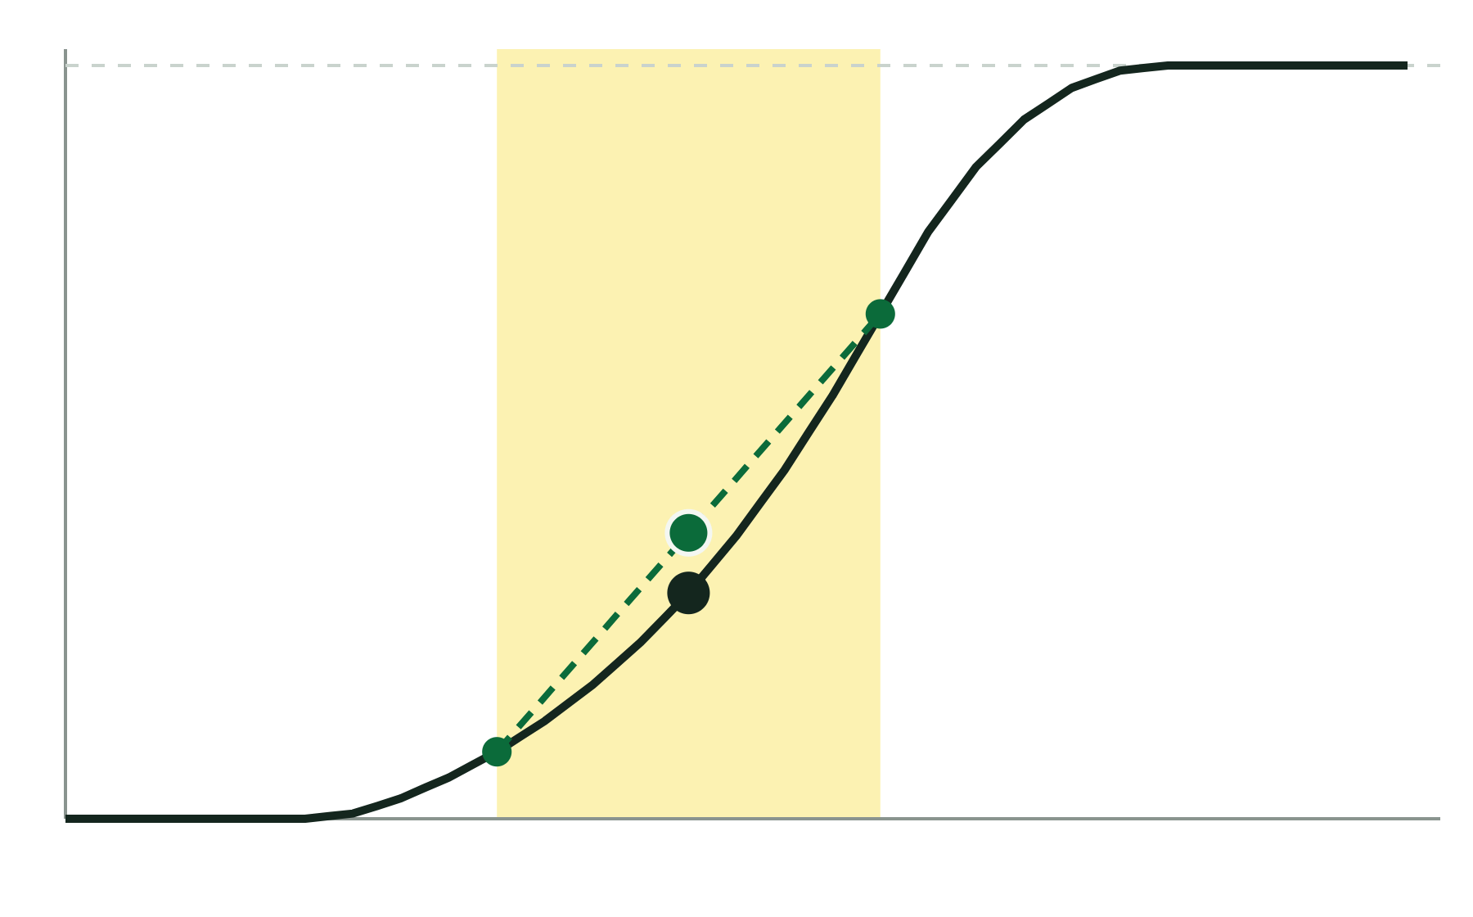
Average the power, not the wind
INSIGHT 2
4,500 kW full power
Average energy bias, baseline → our model
−8.5 % → +1.4 %
average power over the range
Between 3 and 11 m/s the curve bends upward: a gust above the guess adds more power than an equal lull removes.
power at the best guess
So we average the power over the plausible wind range. Alone, this cut the park error from 11.0 % to 9.0 %.
0
5
10
wind speed, m/s
Watt The Hack 2026 · Illustration: power curve of T1–T3 · 5 / 8
Notes:
About 30 seconds. Our biggest single gain. The power curve bends upward exactly where most energy is made. If the wind is a bit higher than our guess, power rises a lot; if it is a bit lower, power drops less. So plugging in the single best guess systematically under-counts energy: the baseline was 8.5 percent too low on average. We average the power over the range of plausible wind speeds instead, which removes the bias: plus 1.4 percent, statistically zero.

Slide 6
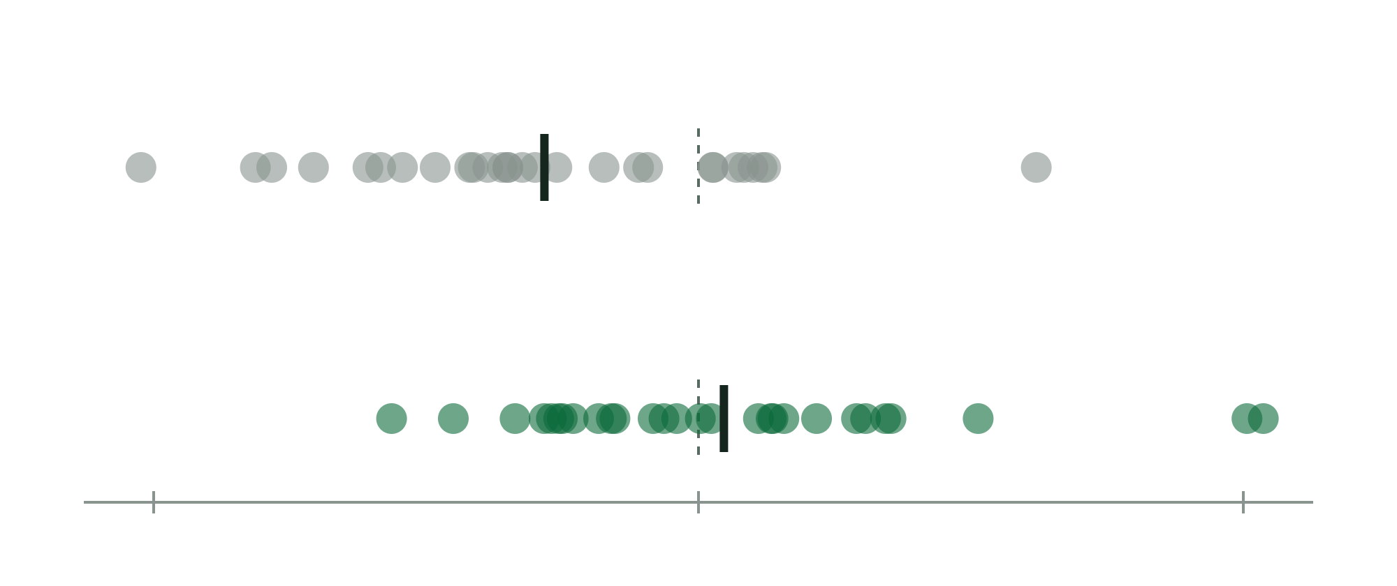
What remains is weather luck, so we show a range
INSIGHT 3
Baseline: too low on average (−8.5 %)
Lost energy, judged outage 1–3 Sep
322 MWh
Our model: centred (+1.4 %); the ±11 % spread stays
95 % range: 262–387 MWh
An outage’s energy error is its 3-day average wind error. Errors fade within hours and hit all three turbines at once.
−30 %
0
+30 %
Watt The Hack 2026 · One dot = one simulated 3-day outage · 6 / 8
Notes:
About 30 seconds. Each dot is one simulated outage. The grey baseline sits mostly below zero: that bias is what we removed. What remains is the spread, about plus or minus 11 percent per outage. We found that an outage’s energy error is simply its three-day average wind error: errors fade within a few hours and all three turbines are wrong together, so nothing in the neighbour data can remove it. That is why we give the insurer a range: 322 megawatt hours for 1 to 3 September, between 262 and 387 with 95 percent confidence, a range built from 83 simulated outages.

Slide 7
The transparent formula beat the black box
INSIGHT 4
Baseline formula
11.0 %
Gradient boosting (black box)
9.7 %
Small neural network
9.1 %
Our transparent formula
8.5 %, best
About 50 variants tested. Most extras (time weighting, time of day, temperature, pressure, curved fits) added numbers, not information.
Watt The Hack 2026 · Mean park energy error over 28 simulated outages, lower is better · 7 / 8
Notes:
About 20 seconds. We also tried flexible models: gradient boosting and a small neural network. Both did worse than our one-line formula, and the black box’s uncertainty band was too narrow. Most other extras added nothing either. So explainability did not cost us accuracy: the transparent model is also the most accurate one.

Slide 8
322 MWh lost on 1–3 Sep, between 262 and 387 MWh
THE ANSWER
1
Tested on 28 simulated outages: park energy error 11.0 % → 8.5 %
2
Averaging the power removed the bias: −8.5 % → +1.4 %
3
One transparent formula, every number explainable, with an honest range
Try it live: [app URL] · upload any outage window, get kWh with a 95 % range
Notes:
About 25 seconds. To sum up: tested on 28 simulated outages, the power fix removed the bias, and the remaining uncertainty is shown honestly as a range. For the judged outage that is 322 megawatt hours, between 262 and 387. Everything runs in our app: pick any outage window and get the lost energy with its range. Thank you.

